Slide 1
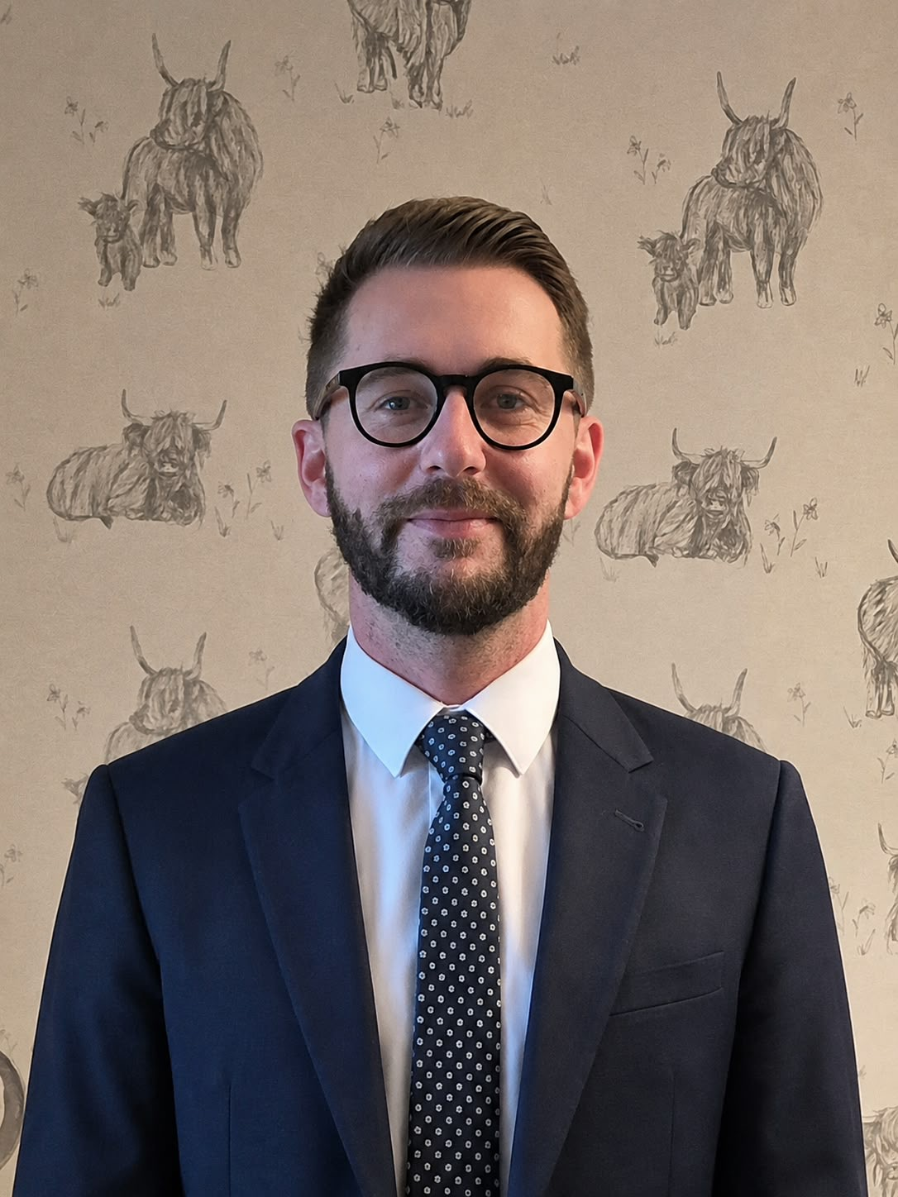
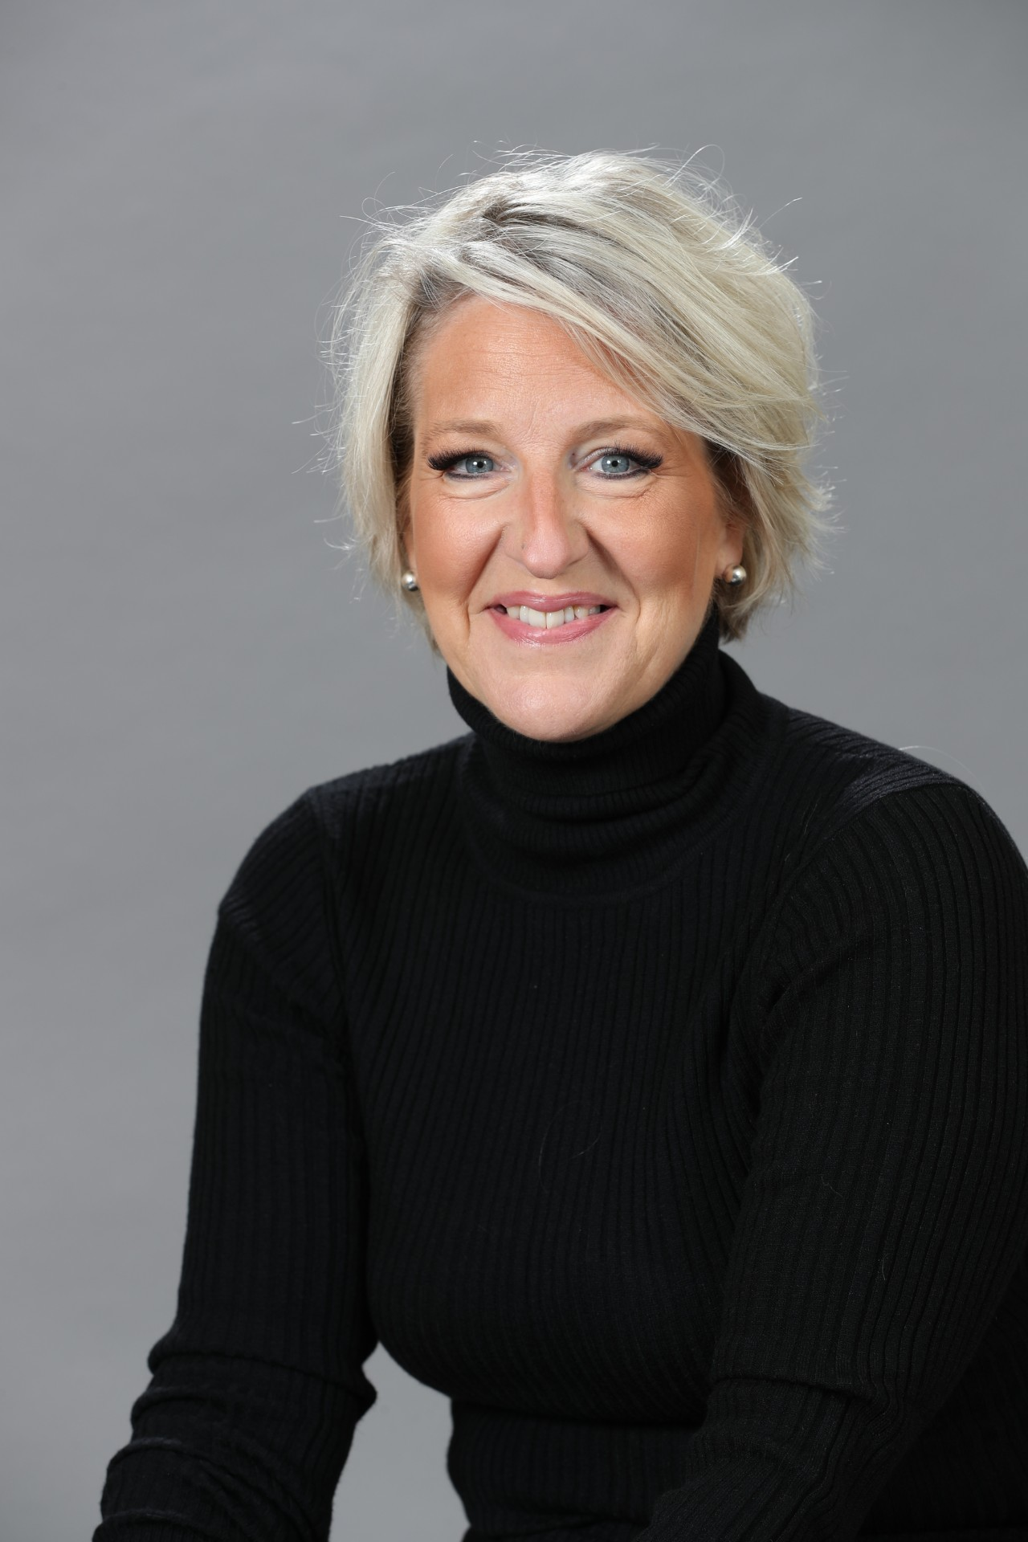
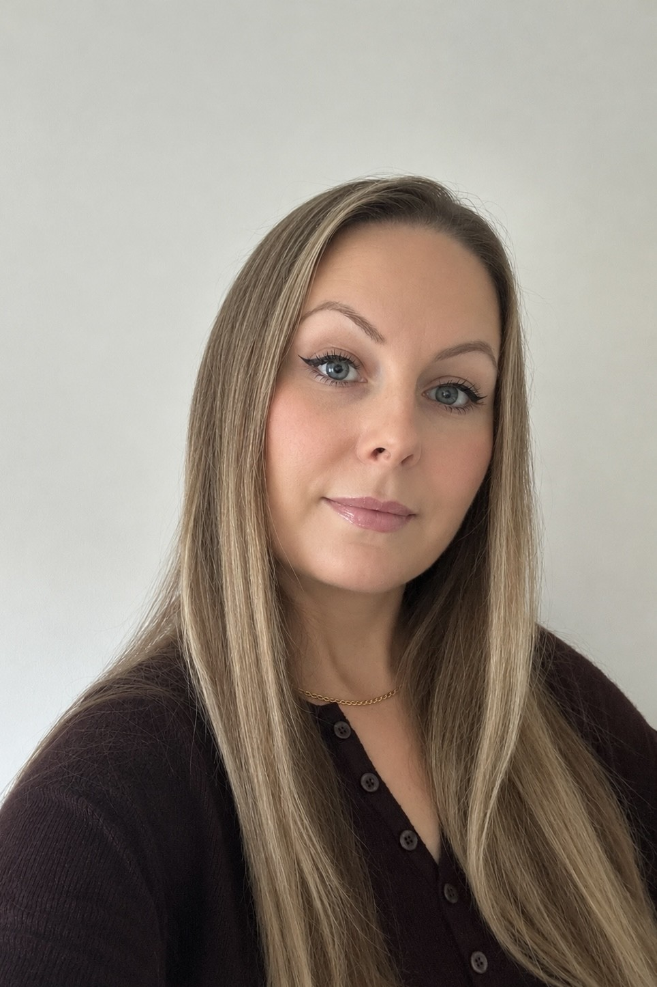




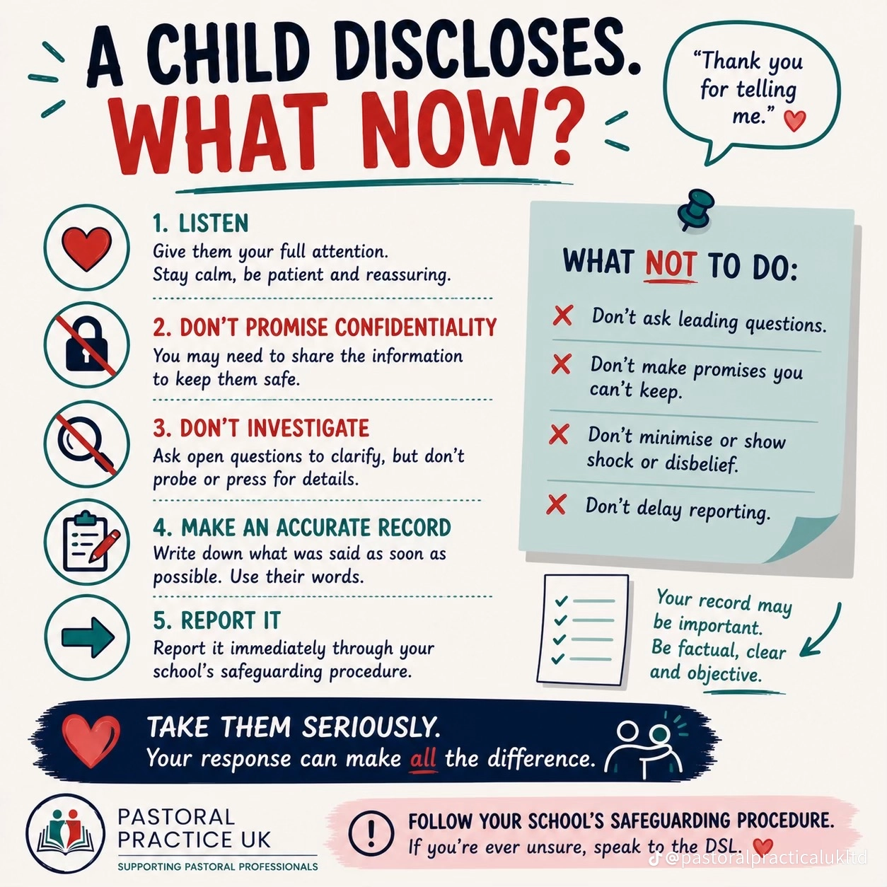
Safeguarding at Crockerton
School
Aaron McCaldon
Head Teacher DSL
head@crockerton.wilts.sch.uk
Kate Woodley
Senior Teacher DDSL
Woodley@crockerton.wilts.sch.uk
Angela Hossain
Safeguarding Governor
angela.gubala@crockerton.wilts.sch.uk
Crockerton CE Primary School
Tel: 01985 212168

